Slide 1
DACdb CRM
A Customer Relationship Management (CRM) System
for
Managing Your Potential and Proposed Members

Slide 2
The Challenge
10:3:1 Rule
  10 Referrals/Contacts/Suspects
  3 Prospects (to a membership event)
  1 New Member
Average Attrition = 14%
40-member club = 6/year
= 60 Suspects, 18 Prospects
= 6 New Members

Slide 3
CRM Overview
What is a CRM?
Customer Relationship Management (CRM) is a term that refers to practices, strategies and technologies that companies use to manage and analyze customer interactions and data throughout the customer lifecycle, with the goal of improving customer service relationships and assisting in customer retention and driving sales growth

Slide 4
CRM Overview
What can I do with the CRM?
  It is a new tool to help clubs and districts manage “Potential” and “Proposed” members – your “membership prospects”
  Download, Import and Manage RI Membership Leads
  Track activities collaboratively
    Track calls placed to Potential/Proposed members
    Enter notes from conversations
    Enter and track emails sent
  Enter tasks to be performed by someone by a future date
    Assign “follow-up” items to members within your club/district

Slide 5
Setup

Slide 6
CRM Setup
The DACdb CRM requires minimal setup:
  Add a “zProspect” club to your district club listing
    This club will be used to contain Potential and Proposed members that have not yet been assigned to a club
    The members on the LEADS list imported from RI & not assigned to a club will be imported into the “zProspect” club
  Assign the “Potential” and “Proposed” member types you want the CRM to manage
  Assign the security levels allowed to perform certain actions within the CRM (e.g., move unassigned members into an “Active” club)
  Define your “Pipeline States”. Theses states defined your process or steps that start with a potential member contact leading to up a full active member.

Slide 7
Pipeline State Setup
By default, the system defines six(6) steps:
  Inquiry (*)
  Club Matching (*)
  Interested
  Decision < 2 months
  Decision 2-12 months
  Proposed Member
Each District can define (rename, add or delete) their own states/steps
The 1st two states/steps will be mapped to Inquiry and then Club Matching/Club Connection as part of the RI import process

Slide 8
Using the CRM

Slide 9
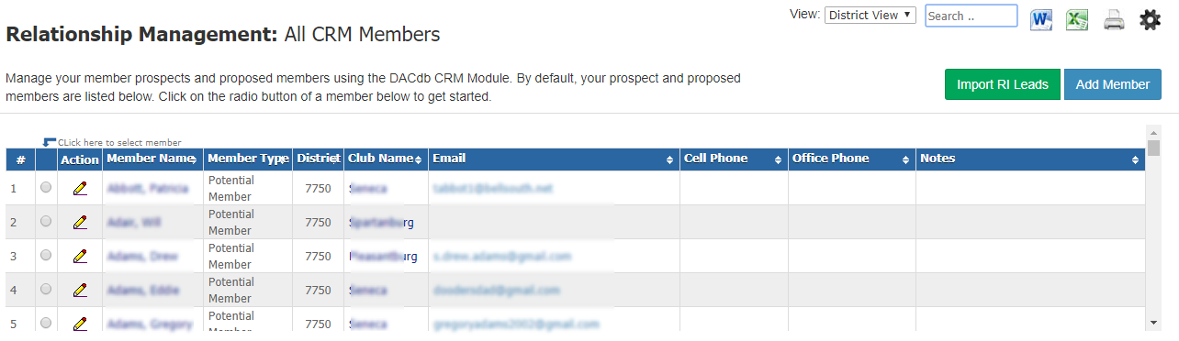
Getting Started
Click on the CRM tab or CRM ICON in the new UI
All membership leads being managed by the CRM will be listed:
Three options:
  (1) Click on the radio button to start working with a specific lead
  (2) Import RI membership leads
  (3) Add a lead into your club in DACdb

Slide 10
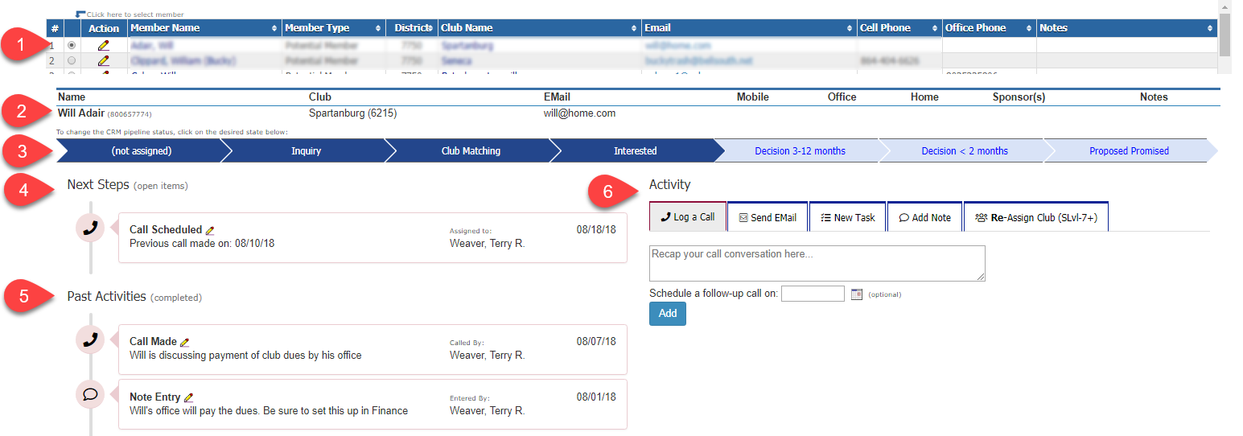
Lead Management Overview
Select Lead (1)
Review Contact Information (2)
View and change “pipeline” state (3)
Review next steps (4)
View previous activities (5)
Record a new activity (6) (e.g., call, email, task, note or club (re-) assignment

Slide 11
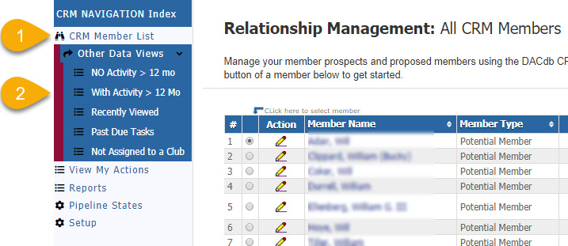
Lead Views
There are six(6) views of your membership leads:
  All Members (s)
  Five other “other” views based on Activity or Club Assignment

Slide 12
Lead Detail
After selecting a specific membership lead, the lead detail will show at the top:
Quick way to view lead for missing data:
  No club assigned
  Missing email (cannot email lead in this case)
  Phone numbers
  Sponsor information
  Review notes – which might have preferred contact info mentioned
Pencil edit on the selected lead record takes you directly to edit their DACdb Member Profile

Slide 13
Lead Pipeline
The lead “pipeline state”:
Click on the state to change it
States are defined by each District under the CRM Step.
The first two (2) states are mapped to RI’s membership lead states

Slide 14
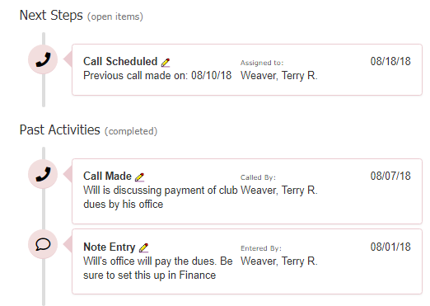
Lead Activities
Next Steps
  An open “task” that is assigned
  to someone else to perform
  Details
    Who needs to do it
    When it needs to be done by
    What needs to be done
Past Activities
  An historical log of emails
  calls, notes, and club
  re-assignments

Slide 15

Entering Lead Activities/Tasks
There are four (4) activities or tasks that can be entered:
A call and the conversation notes can be entered
An email can be sent directly to the prospect
A future “task” can be entered for person in your club or district to perform
A note (a comment or reminder) can be added
** District Admin **:
  A lead can be assigned to a club
  A lead can be re-assigned to a different club

Slide 16
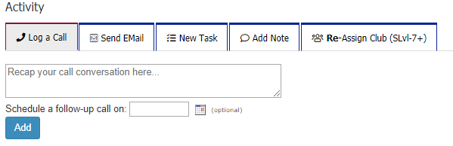
Log a Call
A short recap of a call can be captured:
A follow-up conversation reminder can be entered
  This will appear as a future task on the member activity

Slide 17
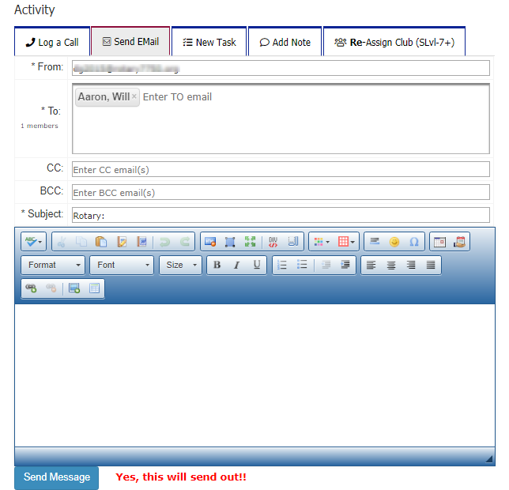
Send an EMail
An email can be sent to the lead:
An email might be, but not limited to:
  An invite to a club meeting
  A request for some
  information
  A thank you
CC and BCC emails
are optional

Slide 18
Enter a Task
A task is a request for someone to take an action or perform some action
Tasks are assigned to ONE (1) individual for accountability
Tasks have a due date when the task should be completed
The individual assigned the task WILL receive an email
The individual assigned the task MAY receive a reminder notification
  Depends on the dates
  Depends on the notification setup

Slide 19
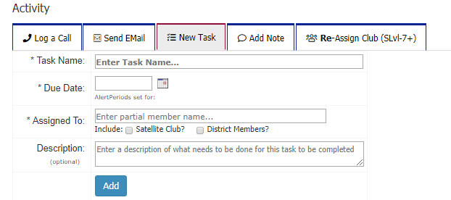
Enter a Task

Slide 20
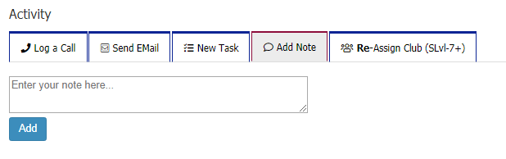
Enter a Note
Notes can be entered for a prospect
Notes can be a comment or recap of a conversation

Slide 21
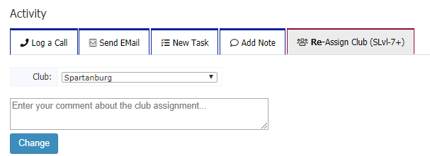
Re-Assign Club
This is a district level function (S-Lvl configurable in Setup)
RI Import process will assign leads to the club or if not assigned by RI to the zProspect Club setup for the district
This function allows the administrator to move a lead from
  zProspect to an Active club
This function ALSO allows the administrator to move a stale lead from one club to another club

Slide 22
RI Membership Lead Import

Slide 23
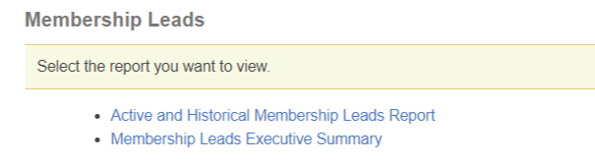
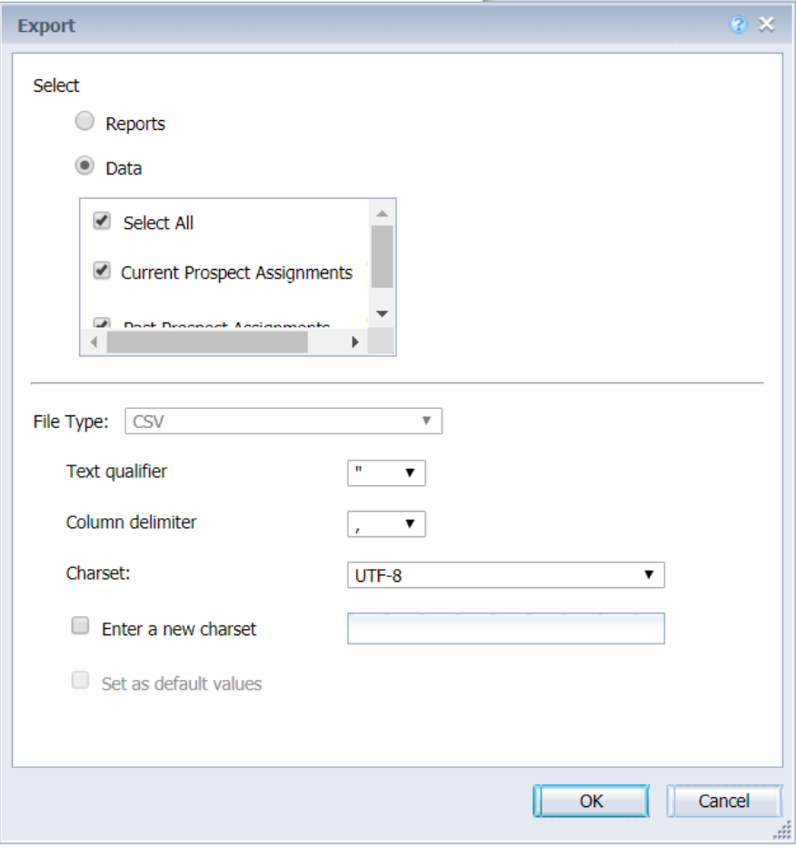
Import RI Data
In My Rotary, navigate to: Manage District Membership Leads, and click “Active and Historical Membership Leads Report”:
Export the leads using the default values
Save this download file on your device

Slide 24
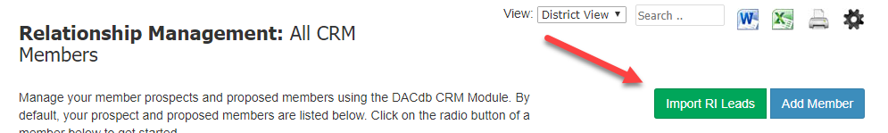
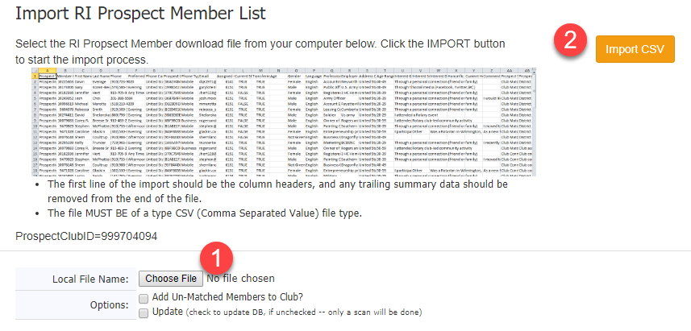
Import RI Data
In DACdb CRM, click on: Import RI Leads button:
Find the local file download above (1)
Click Import CSV
Detailed Instructions
on the
Import RI Leads page

Slide 25
CRM Recap
What can I do with the CRM?
  Manage “Potential” and “Proposed” members – your “membership prospects”.
  Don’t squander a good prospect
  Download, Import and Manage
  RI Membership Leads
  Track activities collaboratively
    Track calls placed to Potential/Proposed members
    Enter notes from conversations
    Send and track emails sent
  Enter tasks to be performed by someone by a future date
    Assign “follow-up” items to members within your club/district

