Slide 1
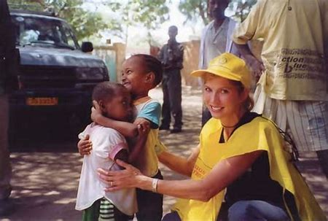
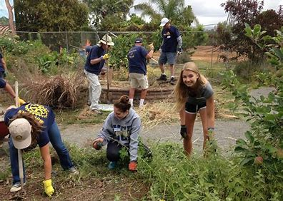
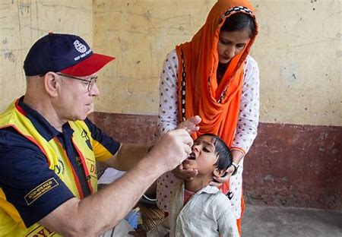
Forest Acres Discover Rotary
We are People of Action
Notes:
Welcome to Discover Rotary. Let’s begin by having everyone do a brief 30 second introduction to include name, vocation and for club members what attracted you to Rotary and what’s kept you coming back and for our potential members, what sparked your interest in Rotary. I am Sandy Olson of the Rotary Club of Forest Acres. My encore career includes teaching life-long learning classes, mentoring and training Rotarians on intentional membership growth strategies. I joined Rotary for friends and fellowship and that kept me coming back for 19 years.

Slide 2
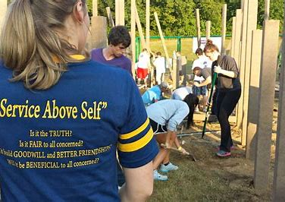
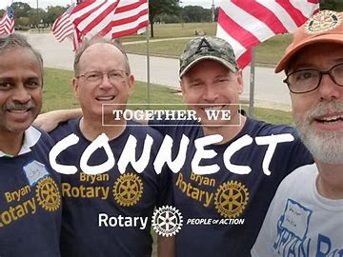
What is Rotary?
1.2 million Rotarians – 35,000 Clubs – 200 Countries
“Service Above Self”
Notes:
Rotary is a membership organization that does service. We are a global network of business and professional leaders. We do humanitarian service projects and encourage high ethical standards. We strive for goodwill and peace in the world. There are 1.2 million of us in 35,000 clubs in over 200 countries around the world. Our motto is Service Above Self.

Slide 3
$200 Million and 16 Million
Volunteer Hours
Rotarians invest more than $200 million and 16 million volunteer hours every year.
Notes:
Rotarians are people of action because we are guided by a strong vision. Together, we see a world where people unite and take action to create lasting change – across the globe, in our communities, and in ourselves. Each year, Rotarians invest more than $200 million and 16 million volunteer hours to promote peace, fight disease, provide clean water, save mothers and children, support education and grow local economies.

Slide 4
What Is Rotary? People Of Action
Notes:
To answer the question what is Rotary… We are the largest most financially sound membership organization whose logo is recognized in more countries than any other in the world. Every minute of every day we feed, we house, we vaccinate, educate, advocate, comfort and provide services. This is Rotary!

Slide 5
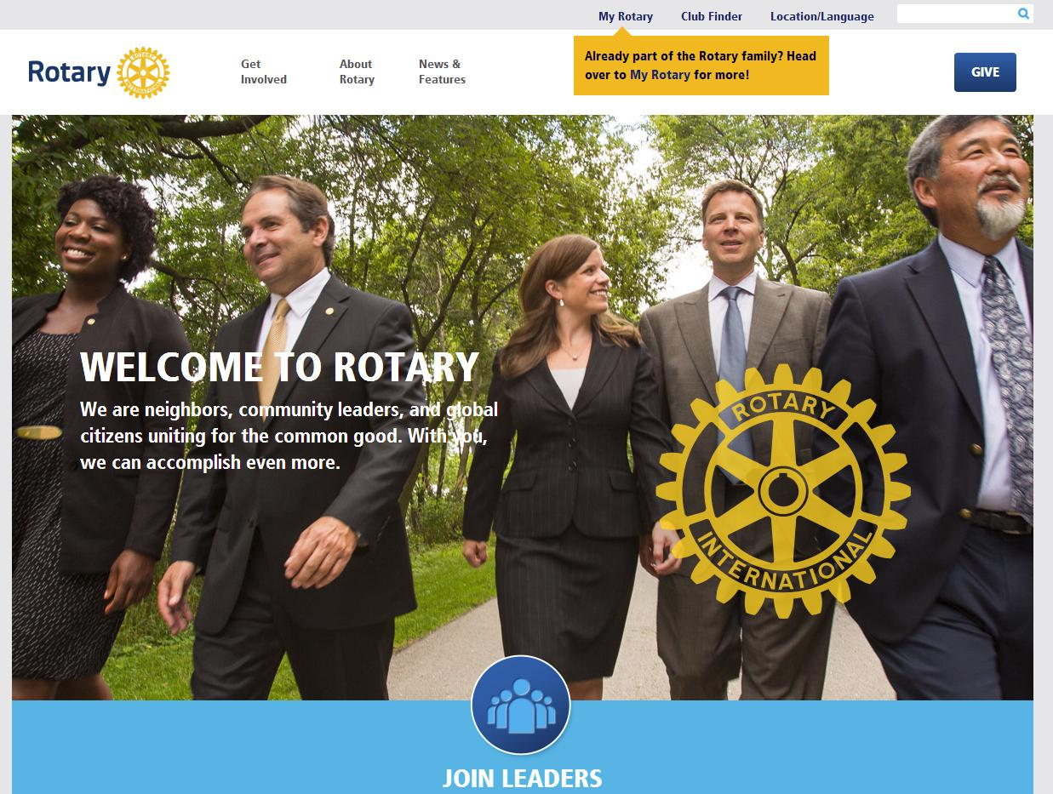
Neighbors, friends, and problem solvers share ideas and take action to create lasting change.
Notes:
Put simply, Rotary is where neighbors, friends, and problem solvers share ideas and take action to create lasting change. It can be a life-changing experience because of the extraordinary people you will meet. Rotarians who will be a mentor and role model for you and who will help you build your business network.

Slide 6
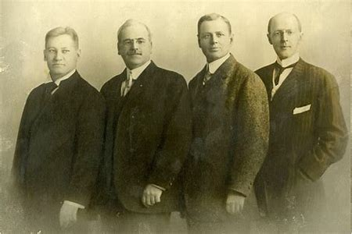
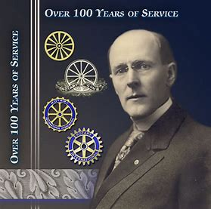
From left: Gustavus Loehr, Silvester Schiele, Hiram Shorey and Paul Harris.
Paul Harris
The first Rotary Club was organized in 1905, by Chicago Attorney Paul Harris.
The original four-member club met for fellowship in rotation at member’s offices…thus the name ROTARY.
Notes:
Great history in how Rotary got started. Paul Harris an attorney in Chicago gathered some friends in 1905 for fellowship and it grew from there. Their first reason for being was FELLOWSHIP. Meetings were rotated from office to office and that’s how Rotary got its name.

Slide 7
Rotary’s Core Values & Four-Way Test
Notes:
The Four Way Test is used by Rotarians world-wide as a moral code for personal and business relationships. It can be applied to almost any aspect of life by asking four simple questions…Is it the truth, is it fair to all concerned, will it build good will and better friendships, will it be beneficial to all concerned. Now some Rotarians have added a 5th question, is it fun? Because while we work hard on our projects, we also like to have fun. The four way test goes hand in hand with Rotary’s Core Values. The world today is very different than it was when Rotary was founded in 1905. But what hasn’t changed are our core values of fellowship, integrity, diversity, service and leadership. You can see on the screen I came across a song about the Four Way Test and if we had time we’d have Terry Weaver sing it for us. But since we are pressed for time, we’ll let him off the hook.

Slide 8
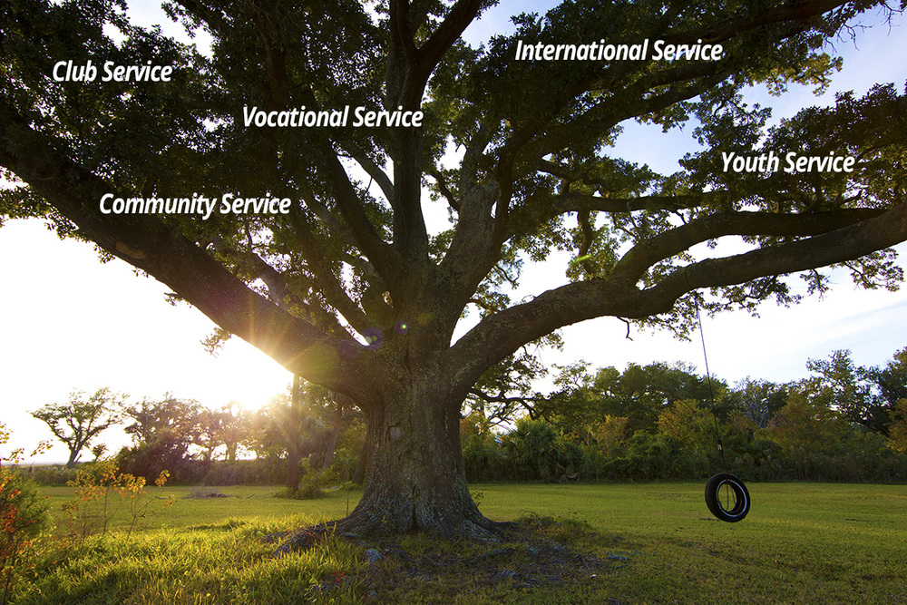
We implement the Object of Rotary through Five Avenues of Service
Notes:
The Object of Rotary is four principles developed over the years to provide Rotarians with a strong, common purpose and direction. They serve as a foundation for our relationships with each other and the action we take in the world. The Object of Rotary comes to life through Five Avenues of Service which are the branches of a deeply rooted membership organization, and they are: Club Service, Vocational Service, Community Service, International Service and Youth Service. This is how we reach out and make a difference in people’s lives around the world and right here at home.

Slide 9
Seven Areas Of Focus
Peace & Conflict Prevention
Education & Literacy
Disease Prevention & Treatment
Water Sanitation & Hygiene
Community Economic Development
Maternal & Child Health
Supporting The Environment
Notes:
Seven Areas of Focus help us build international relationships, improve lives, create a better world, support peace and end polio forever. All critical humanitarian issues Rotarians have been working on for many years.

Slide 10
$4 billion spent on life-changing projects
Notes:
Rotary has a non-profit foundation that promotes world understanding and peace. Since it was founded more than 100 years ago, the Foundation has spent more than $4 billion on life-changing, sustainable project from preventing disease to providing clean water, supporting education, growing local economies, saving mothers and children and promoting peace.

Slide 11
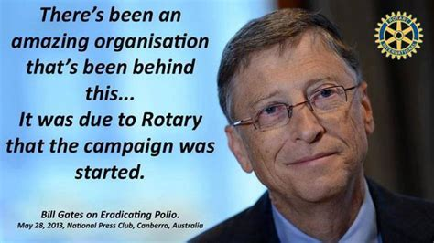
99.9% Reduction Of Cases Worldwide
Notes:
The Rotary Foundation is best known for its work to end polio in the world. Polio Plus was launched in 1985 and has reached a 99.9% reduction in the number of Polio cases world-wide. The Bill & Melinda Gates Foundation joined Rotary in 2017 to commit $450 million to end polio.

Slide 12
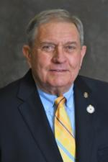
Rotary International District 7770
Forest Acres Rotary Club
Founded December 4, 1967
2020-21 Club of the Year
$30,000 Annually Community Service Organizations
Co-Sponsor Annual Forest Acres Festival
2022-23 District Governor
Bob Gross
Notes:
The Rotary Club of Forest Acres is one of 74 clubs in District 7770 that includes 25 counties in eastern South Carolina. Our 2021-22 District Governor is Paul Walter, a member of the Rotary Club of Hilton Head Island but he originally joined Rotary in Spartanburg in 2001. Our Forest Acres Club used to be known as a small club with a big heart but so many people have joined the club over recent years, we are now a medium size club with an even bigger heart as we give approximately $30,000 annually to non-profit community service organizations. We’re known best for the Forest Acres Festival which we have co-sponsored with the City of Forest Acres for over 20 years.

Slide 13
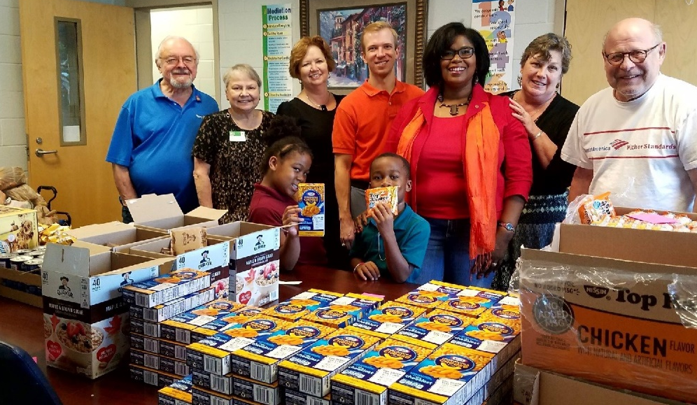
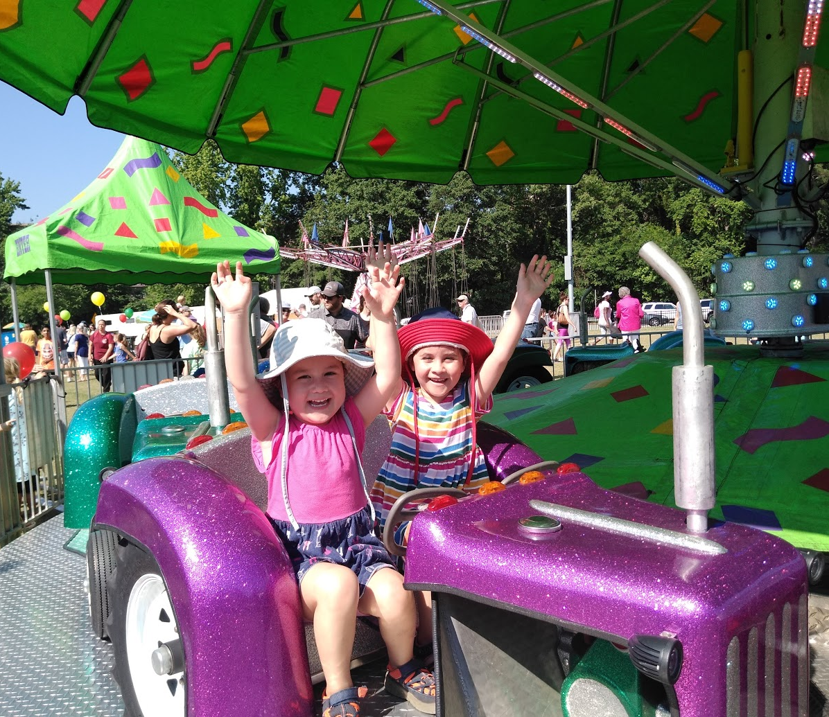
The Rotary Club of Forest Acres
Projects:
Happy Feet
Ready2Read
Back-Pack
Books for Birthdays
Rise Against Hunger
One Warm Coat
Notes:
We have several service projects throughout the club year from making sure students have new shoes to start school with to fighting hunger and promoting literacy. We raise money through sponsorships of the Forest Acres Festival.

Slide 14
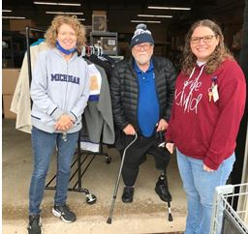
300 Coats Distributed To Community Service Organizations
Notes:
A new project for our club this year was a coat drive held during the month of October. It involved 100% of our club members and we successfully collected 300 hundred coats and distributed them to 10 different community service organizations.

Slide 15
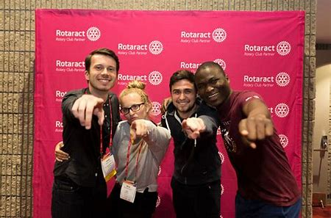
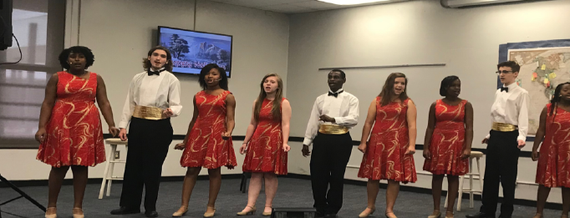
Pop, Broadway & Jazz Group Richland NE High School Interact Club
Notes:
Rotarians believe in developing the next generation of leaders. Our programs help young people build leadership skills, expand education and learn the value of service. They may join Interact Clubs for those age 12-18 and Rotaract Clubs now available for anyone 18 and older. There are a number of grants and scholarships available from Youth Exchange to Rotary Peace Fellowships.

Slide 16
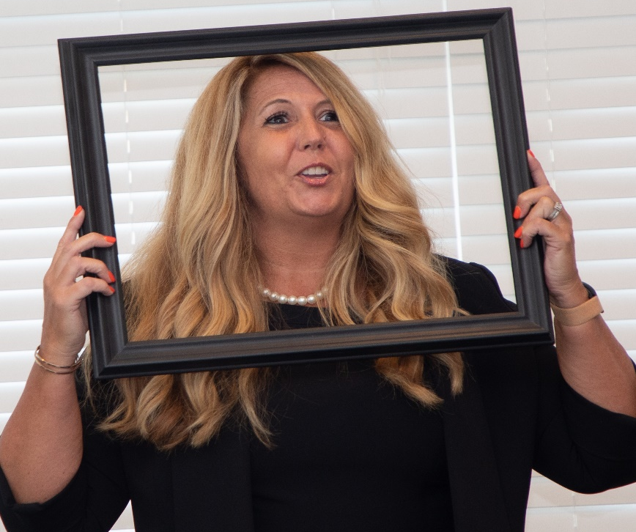
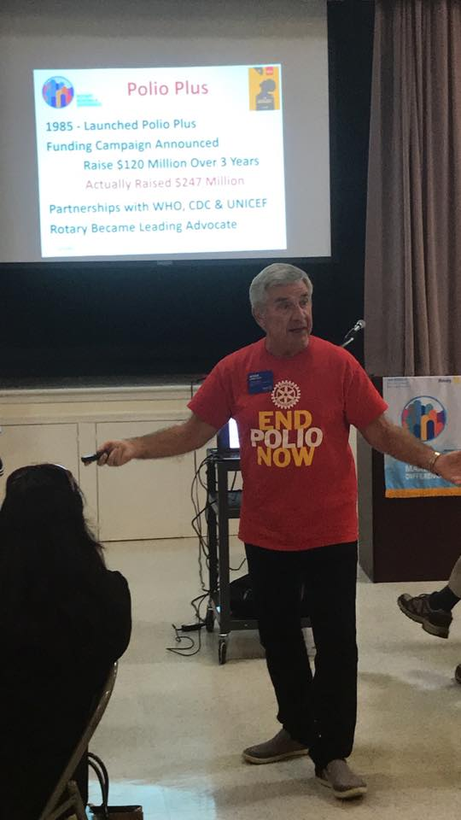
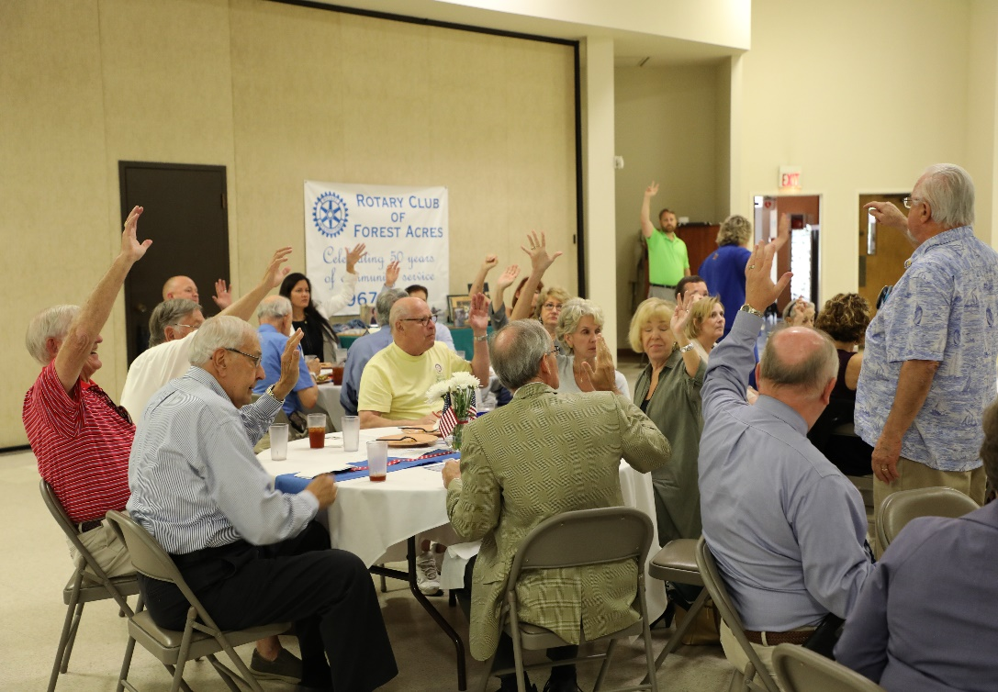
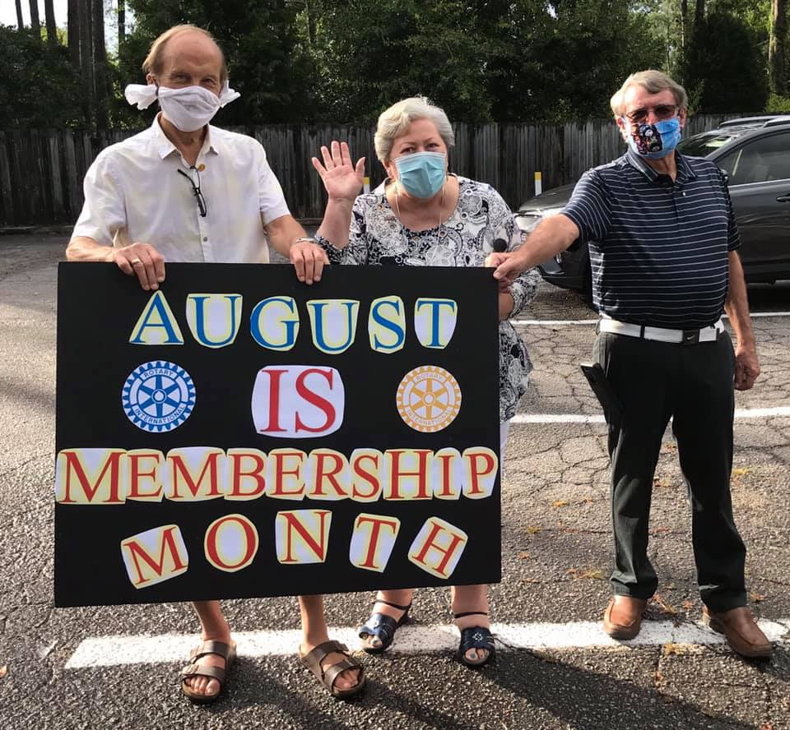
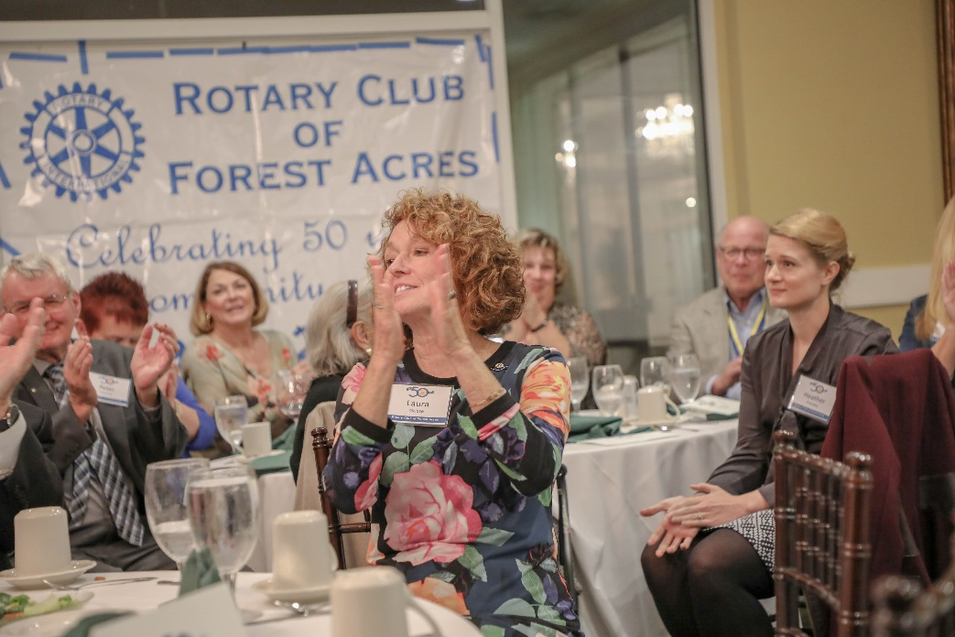
Notes:
Forest Acres is now recognized as one of the most vibrant clubs in D-7770. We were recently honored as the 2020-21 Medium Club of the Year in our District. We have fund club meetings and great speakers, and while we work very hard on our projects and fundraisers…

Slide 17
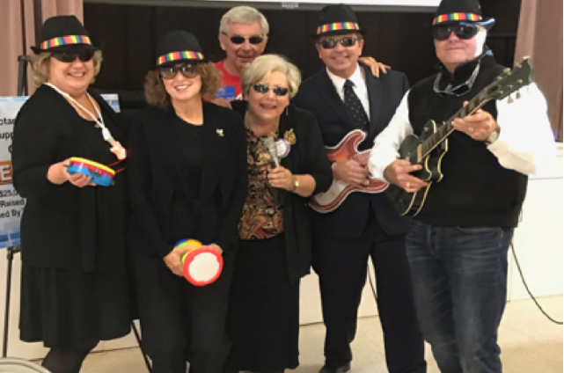
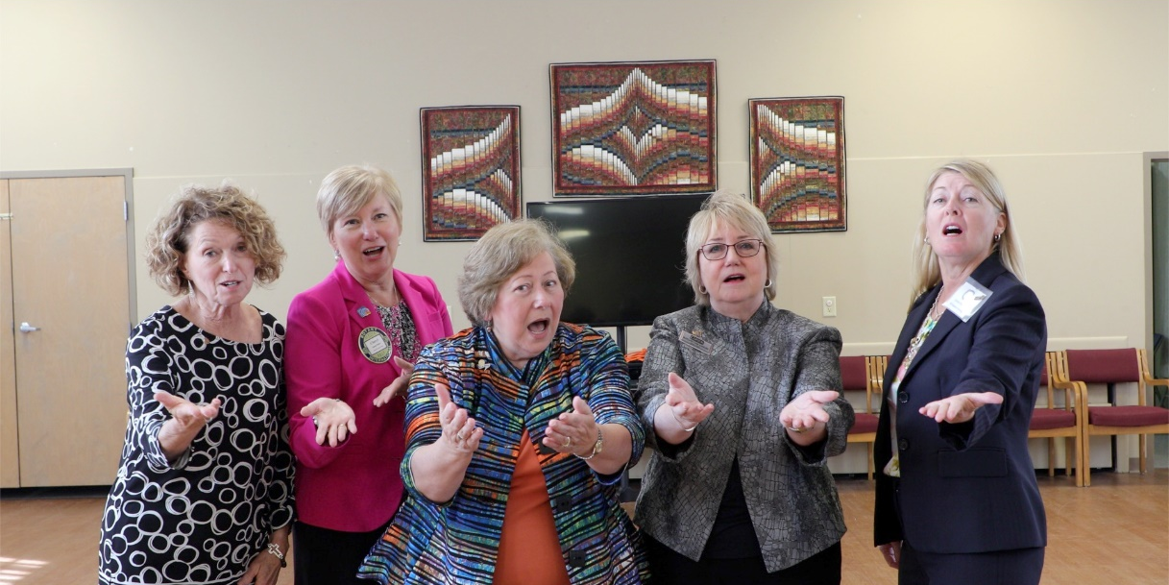
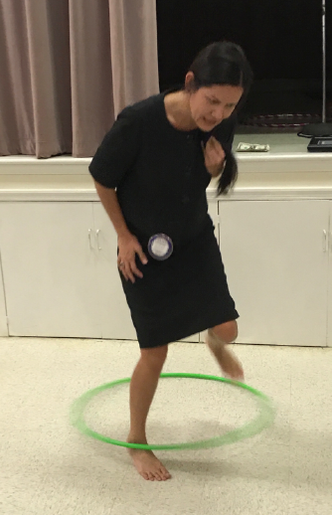
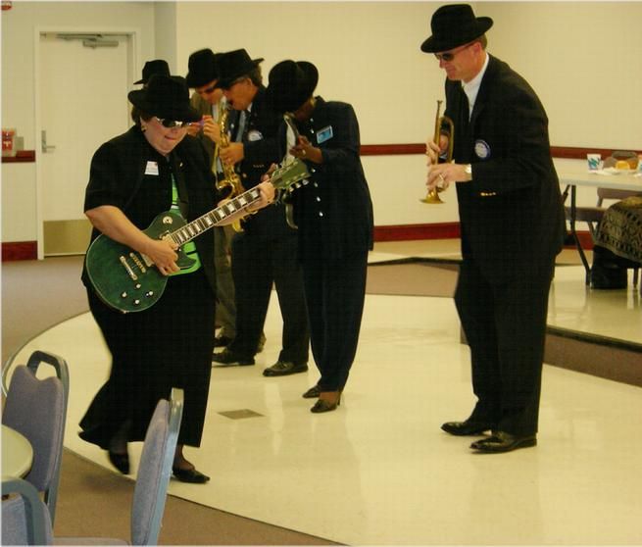
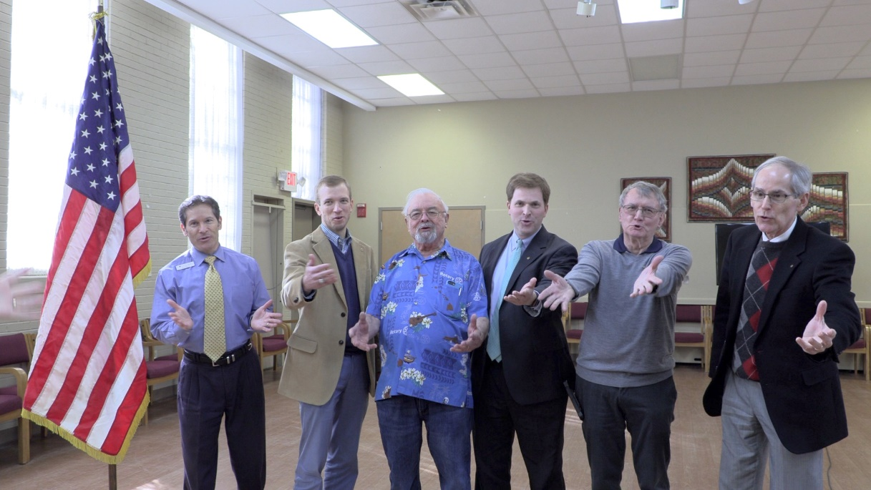
A Vibrant Club!
Forest Acres Rotarians Have Fun!
Notes:
We also know how to have fun! From performing as the Blues Brothers and Sisters to Hoola Hoop contests, and a Chorus Line!

Slide 18
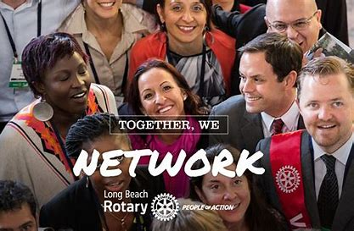
Why Join Rotary
Friendship, camaraderie and fun
Give back to community
Be part of something larger than yourself
Professional networking
Leadership training
Personal growth and recognition
Just a few of the reasons millions of people joined Rotary over the past 117 years
Notes:
There are many good reasons to join Rotary. Life-long friends, making the community a better place, being part of something larger than yourself, networking, leadership and personal growth. These are just a few of the reasons why millions of people have joined Rotary over the past 117 year. Yes, Rotary celebrates 117 years of service on Feb 23rd. I’d say we look pretty good to be 117 years old.

Slide 19
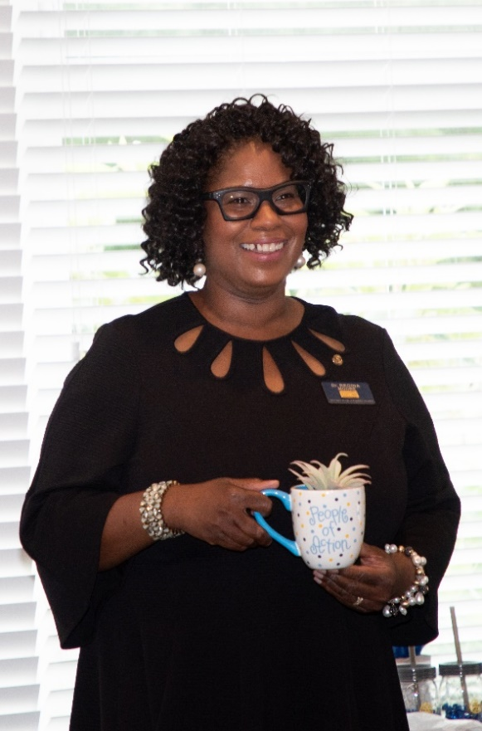
How To Join Rotary
New members become quickly involved in club activities, events, and consider leadership positions.
Notes:
There is a process for joining Forest Acres Rotary. Membership is by invitation from a Rotarian. You submit a completed membership proposal form and when the board of directors approves your membership, you are inducted into the club. You are assigned a new member mentor and attend new member orientation training. But most important of all…you become quickly involved in club activities and events and eventually we encourage all new members to consider a leadership position in the club.

Slide 20
Forest Acres Quarterly Dues
Quarterly Rotary International & District Dues $32.00
Quarterly Rotary Foundation Donation $25.00
Quarterly Club Meals & Dues $118.00
Total Quarterly Dues: $175.00
Notes:
It costs $175 quarterly to be a member of Forest Acres Rotary. That covers RI and District Dues as well as a subscription to the Rotary Magazine. It also includes club dues and meal costs since we are a weekly lunch club.

Slide 21
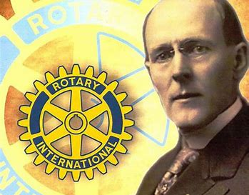
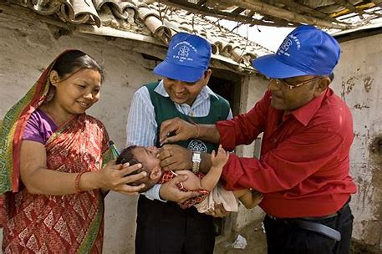
“If you have the love of your fellow men in your heart, my friend, you are a potential Rotarian.”
Notes:
Paul Harris said it best when describing what it takes to be a Rotarian when he said, “if you have the love of your fellow men in your heart, my friend, you are a potential Rotarian.”

Slide 22
Thanks for your interest in Forest Acres Rotary Now 48 members strong and the best club in all of District 7770!
Notes:
Thanks for your interest in Forest Acres Rotary

Slide 23
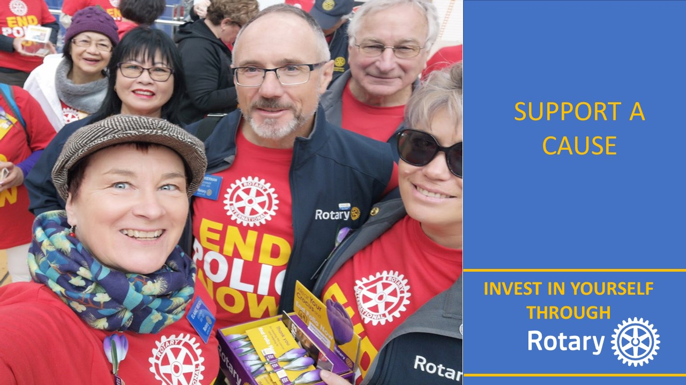
What Could You Bring To Rotary?

Slide 24
What Could Rotary Bring To You?

Slide 25
What Happens Now
Hand out Membership Proposal Forms
Invite to stay for regular meeting (meal on the club)
Follow-up PMail that afternoon or next day
Mark DACdb Potential Member profile with DR date
Pmail Sponsors, asking them to follow up with a phone call and let us know the decision-making timetable
Every 60-90 days, ping sponsors of active prospects, asking them for “No”, “Yes”, or “Not Now”

Slide 26
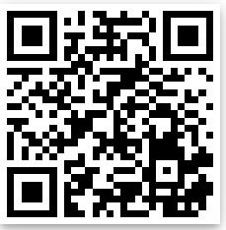
Discover Rotary Toolbox
rizones33-34.org
Search Box: Discover
Browse Toolbox

Slide 27
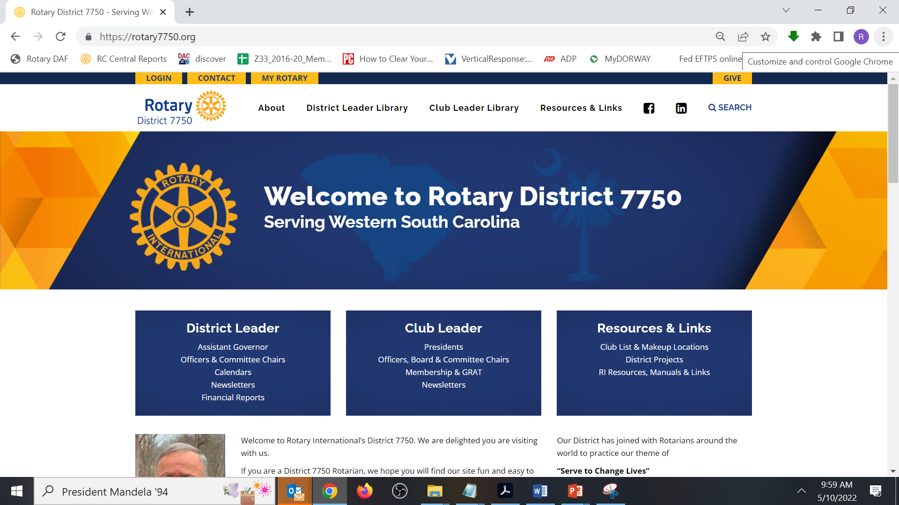
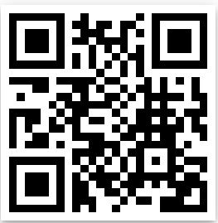
rizones33-34.org
https://www.rotary7750.org

Slide 28
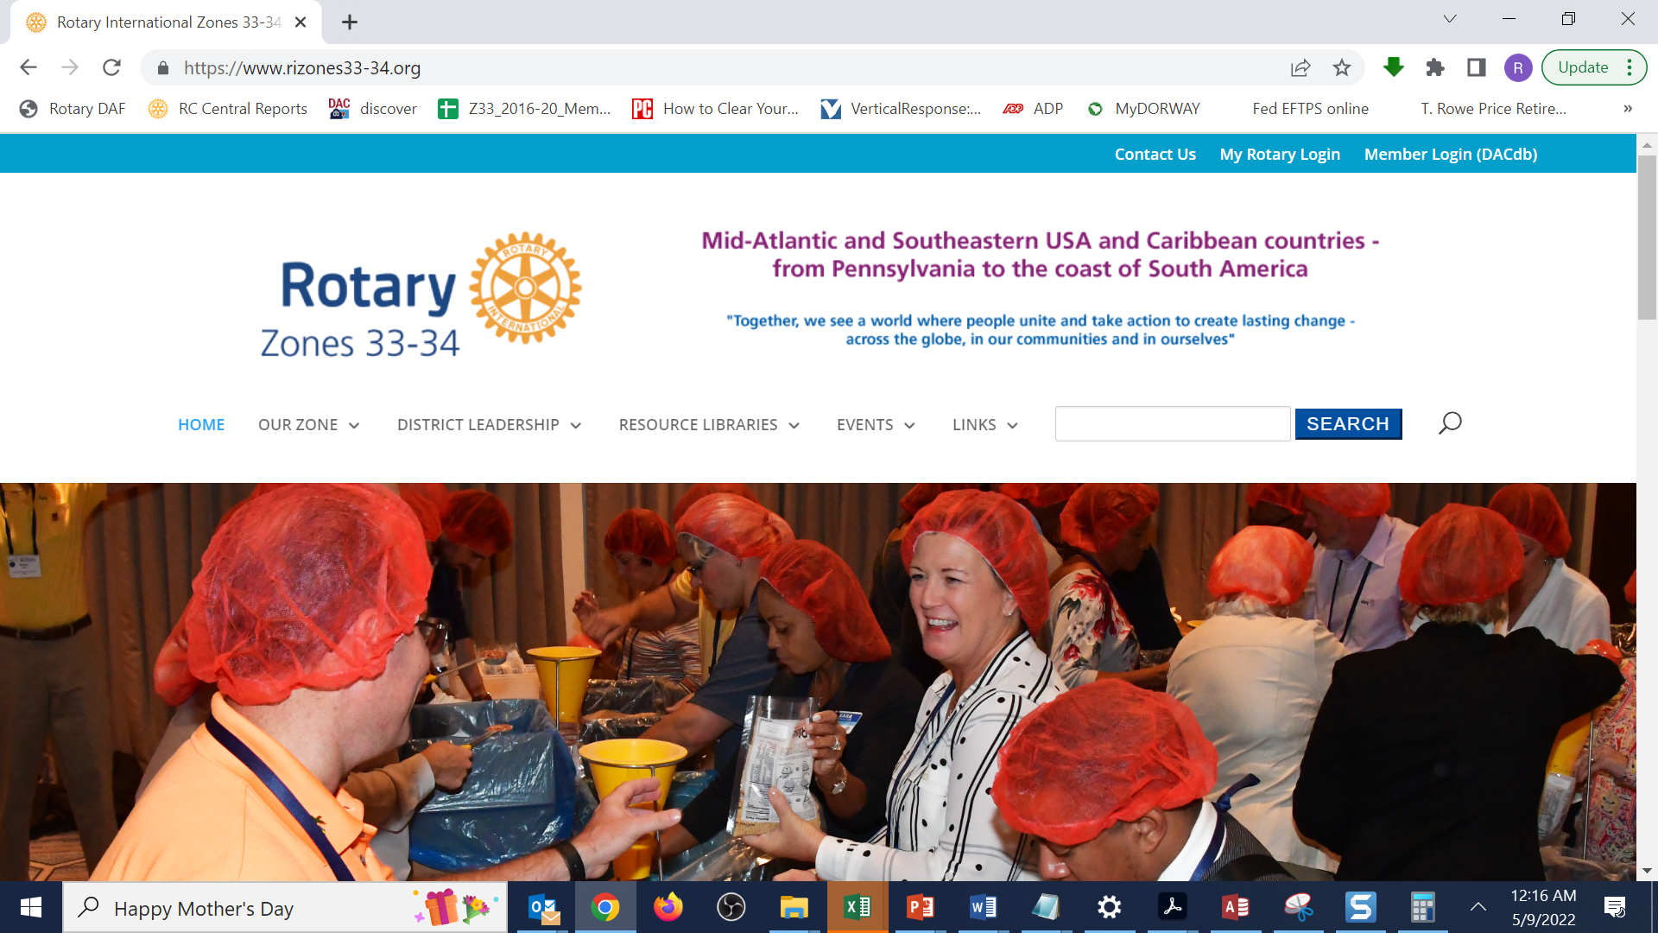
https://www.rizones33-34.org
Discover

Slide 29
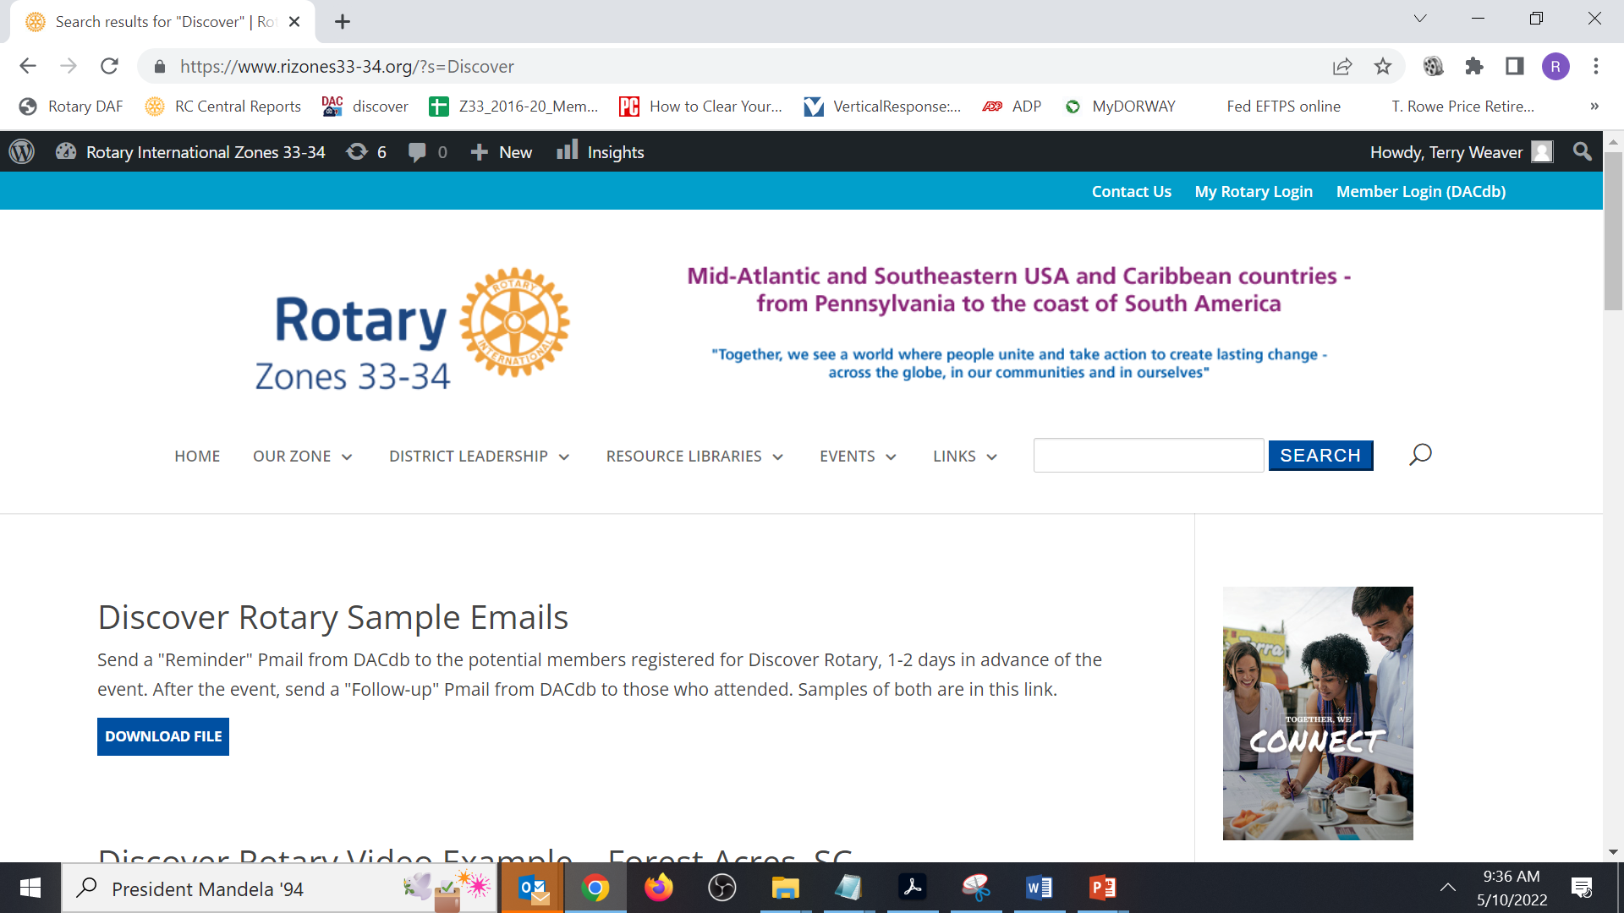
https://www.rizones33-34.org/?s=Discover

Slide 30
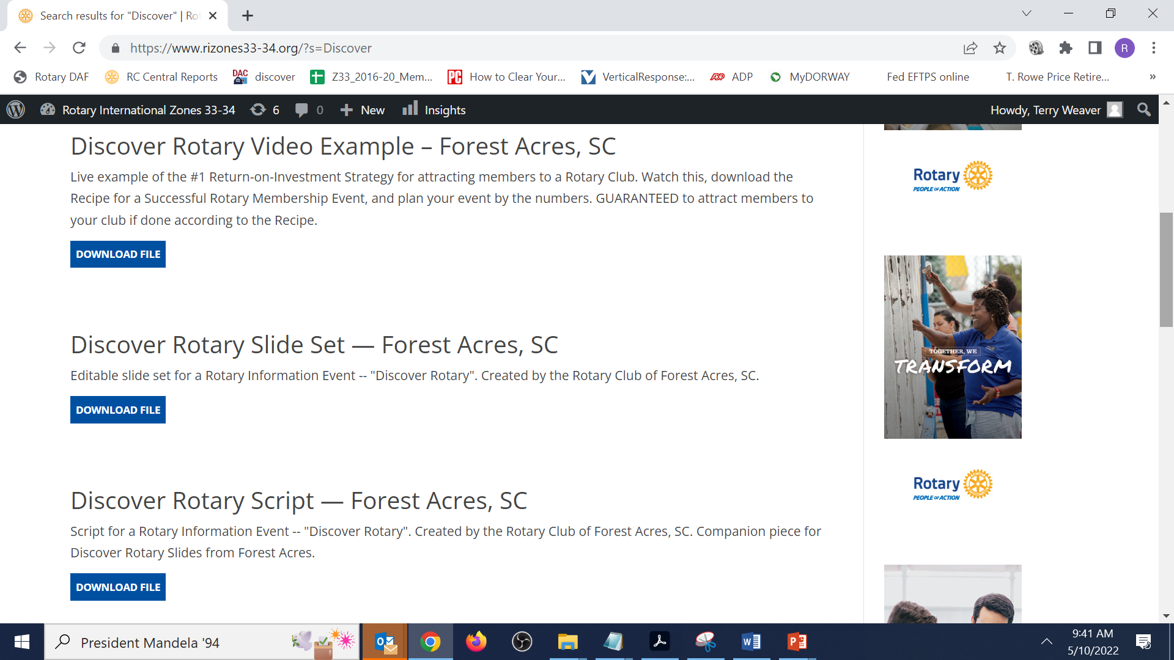
https://www.rizones33-34.org/?s=Discover

Slide 31
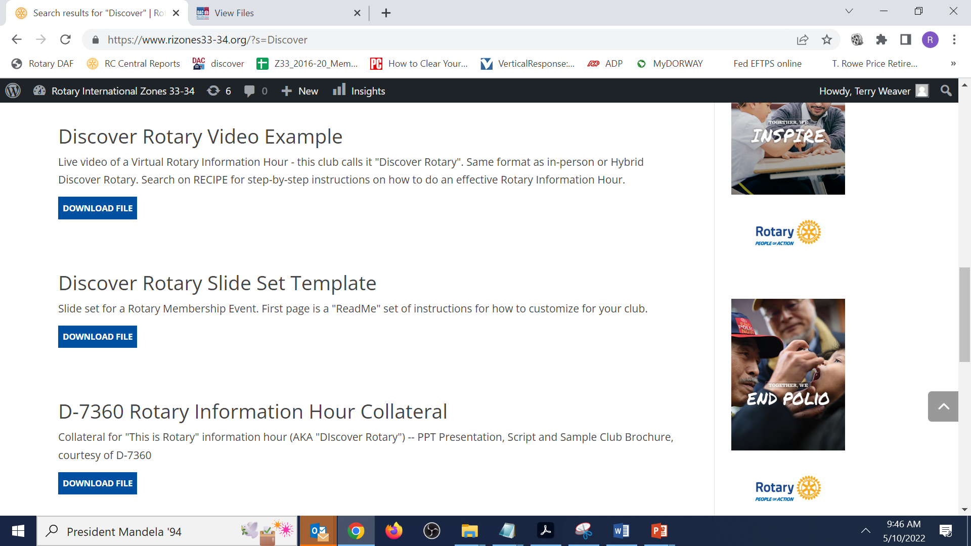
https://www.rizones33-34.org/?s=Discover

Slide 32
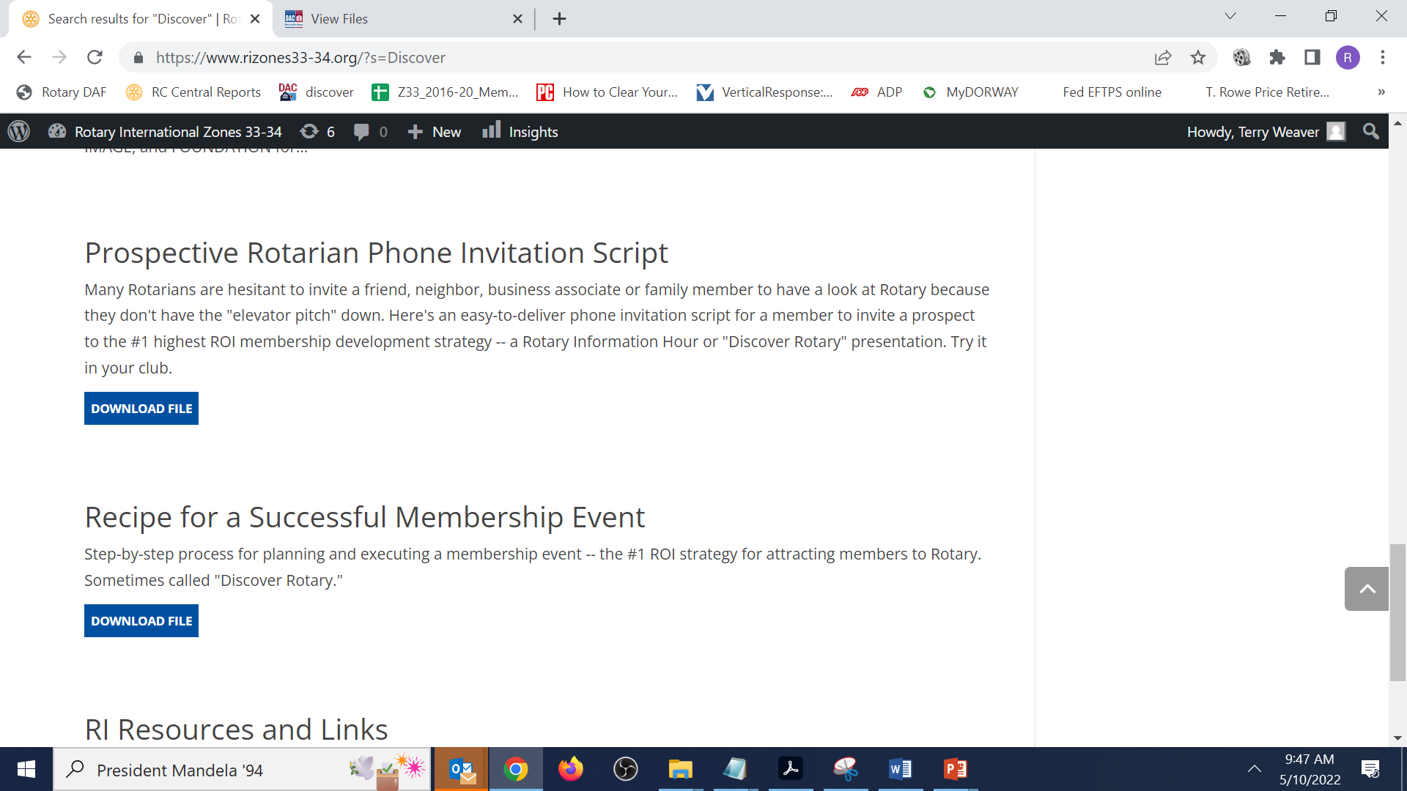
https://www.rizones33-34.org/?s=Discover

Slide 33
Today’s Nuggets
Recipe For Success
Discover Rotary Demo
Discover Rotary
Toolbox

