Slide 1

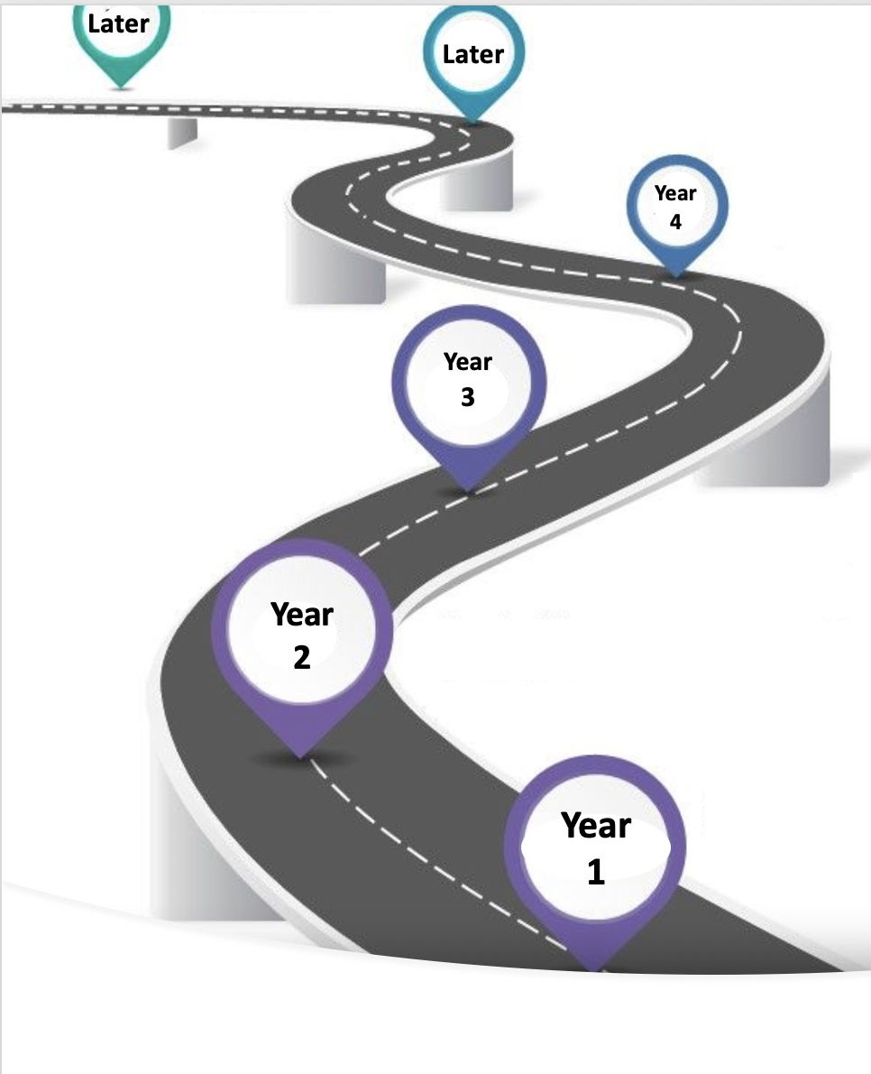
Later
A General Road Map for new Club Members’ Responsibilities
In your 4th year as a Club Member, you may be asked to:
Serve as President-Elect or President Nominee
Oversee a Service Project that you have a passion for
Continue to attract new Members & develop the club
In your 4th year as a Club Member, in addition to 1st year duties, you may be asked to:
Mentor other Rotary members
Provide new ways of energizing/ “livening up” the meeting.
In your 3rd year as a Club Member, you may be asked to:
Serve as a Board Member (attend monthly 1 hour Board meetings).
Serve as Treasurer, Secretary, or President-Elect
Organize and lead a Service Project that you have a passion for.
In your 3rd year as a Club Member, in addition to 1st year duties, you may be asked to:
On occasion, fill in for the President during his/her absence
Help to provide admin support/fill in the gaps as needed
In your 2nd year as a Club Member, you may be asked to:
Serve on a Committee (Membership, Projects)
Asked to lead a project that you have a passion for
Be a Rotary buddy for a new member
In your 2nd year as a Club Member, in addition to 1st year duties, you may be asked to:
Take a more active role in the meetings
Be a Rotary buddy for a new member
Invite prospective members to a meeting, Discover Rotary event or social
Regarding Service Projects, you will be asked to participate as your competing priorities & schedule allows with the following projects:
Beautiful America – trash pick up 1 hour/qtr.
Organize a project – your passion – 1 hour/qtr.
Offer up any service project that touches your heart/ignites your passion & is connected to one of our seven causes: Water & Sanitation, Basic Education & Literacy, Disease Prevention & Treatment, Maternal & Child Health, Peace & Conflict Prevention/Resolution, Economic & Community Development and Protecting the Environment
In your 1st year as a Rotary Club Member, you may be asked to contribute to your Club Meeting by:
Saying an Invocation or Rotary moment
Leading a short song to open the meeting
Gather up “Happy Bucks”
Conduct the 50/50 raffle
Provide a speaker (once or twice in a year
Lead in the Four Way Test of the things we think, say, or do
NOTE: This is only a general guideline. As Rotarians we have busy lives & cannot always follow this path. Your voluntary, engaged membership is what we desire most.

